Slide 1
Assignment 2: Robserv
Oli Bills
ofb@ecs.soton.ac.uk

Slide 2
What’s the problem?
“I think my server has been hacked!”
Rob is concerned his server for his website has been hacked, and after all the help you gave him with his bank, he’s asked you to help him out!

Slide 3
Your task
Identify if the server has been compromised
Assess the server for any potential vulnerabilities
Fix any found vulnerabilities
Write a report
What have you found
What have you fixed, and why
What other recommendations are there

Slide 4
Your task – Part II
You will be given the server from another group
Have they fixed the vulnerabilities?
Are there any remaining?

Slide 5
Assignment 2
You will be working in groups
3 major parts
Assessment
Correction
Reassessment
The full specification is available here:
https://secure.ecs.soton.ac.uk/noteswiki/w/COMP6230-1617-cw2

Slide 6
Groups
The list of groups can be found at:
https://secure.ecs.soton.ac.uk/noteswiki/w/COMP6230-1617-cw2groups
You will be working as a group for this assignment
You should have 1 single VM that you all work on
You should have 1 single report, that you all contribute to
You must work as your group in the lab sessions!

Slide 7
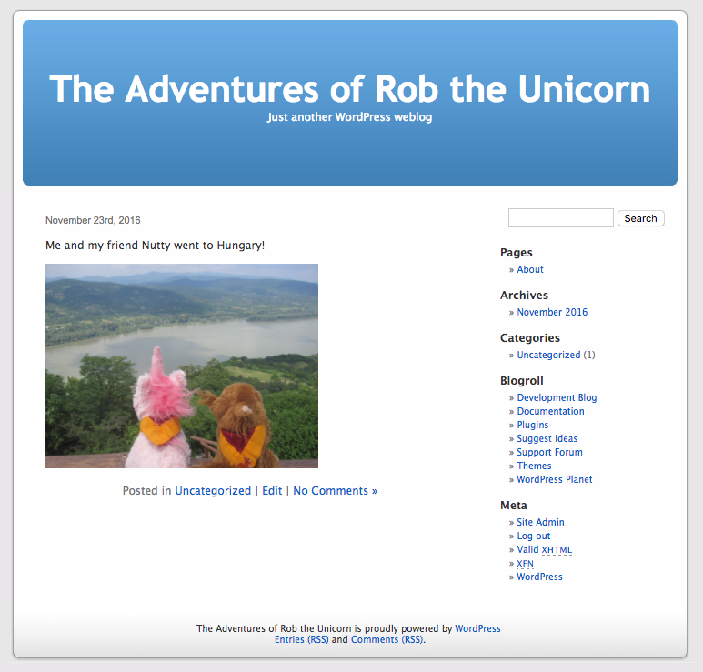
RobServ
This is Rob’s personal web server
It keeps his files and his personal website, which uses WordPress

Slide 8
The specification
You need to make sure that the intended functionality is preserved.
Rob says:
I want the server to have my adventures of Rob website on it, available publicly.
I want the root account and the Wordpress admin to have the password ‘unicorn’.
I like to put files onto the website using Samba, manage my databases remotely, but also to be able to SSH in to it to manage it
It needs to be able to send out emails from Wordpress.
It should take a daily backup in case anything goes wrong.”

Slide 9
It’s a Virtual Machine
Robserv is a virtual machine
You must use VirtualBox to run and work with this virtual Machine
Please do not use VMWare
VirtualBox is on the ECS Lab machines
VirtualBox can be freely downloaded from http://virtualbox.org
Download the virtual machine and put it on the X: drive
DO NOT USE IT FROM YOUR H: DRIVE!

Slide 10
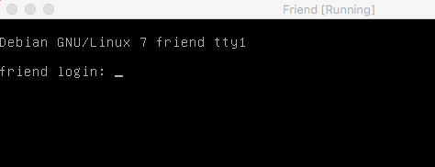
Getting Started
Download the Virtual Machine
Open Virtual Box
Go to File -> Import Appliance
Import the Virtual Machine
Run the Virtual Machine
Once it has booted, log in
Get the IP address
Access the Virtual Machine

Slide 11
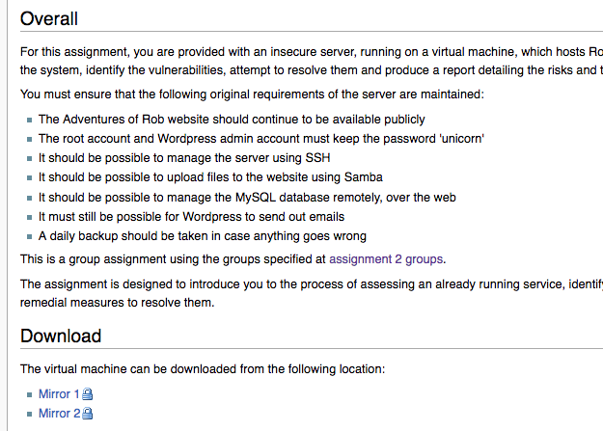
Download it from the Notes Wiki

Slide 12
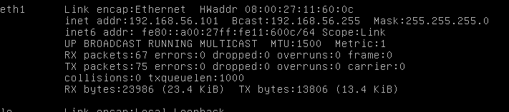
How to get the IP address?
Use ifconfig and find the second network adapter (eth1), which has an IP address which you can use to connect to it

Slide 13
What do you need to do?
Week 8
Assess the server
Identify any vulnerabilities
Week 9
Resolve the vulnerabilities
Produce a report
DUE 8th December: Your ’Fixed’ Virtual Machine, Draft Report
Week 10
Assess another server against your vulnerabilities
DUE 15th December: Your Final Report

Slide 14
This Lab
Get your virtual machine working
Take a look around and see what you can learn
What should be there?
What shouldn’t be there?
What services are there?
What configuration issues are there?
What other issues can you see?

Slide 15
This Week
Continue to explore the system, it’s services and it’s vulnerabilities
Begin putting together a rough list of what you find
Start exploring how to correct the issues you have identified
Next week we will cover this in more detail!

Slide 16
The Report
You will need to submit a report consisting of
What issues you found
What resolutions you did to correct those issues
What further recommendations you would like to make
The result of your reassessment (Part II)
Full template is available at https://secure.ecs.soton.ac.uk/noteswiki/w/COMP6230-1617-cw2report

Slide 17
The Report
Must be a plain text report.txt file, written by your group
Your names and group
Executive summary
Vulnerability assessment
Remedial action
Reassessment (part II)

Slide 18
How do you begin?
Look around the server, and learn what is on it
What services are there
What open ports are there
What file structure is there
What users are there
How is it configured
How does it work
Then begin to look for vulnerabilities
What can you do that you shouldn’t be able to do
What isn’t needed
What isn’t working properly
Then begin to look for exploitation
Are there any signs that the server has been compromised?

Slide 19
This is where your exploration comes in
You have full admin access to the server, so you can find everything on it
You will need to read documentation
Learn about the services that are available
You will need to learn about configuration
What has been setup incorrectly
You will need to learn as you go along
You will need to think for yourself

Slide 20
Worked Example: The Web Server
We know that there is a web server
We check to see if we can access it
We browse through the site and see what is there
We then try to find out how it is setup on the server
Find what is running
Find where the application is
Find where the configuration is
Explore the configuration to learn more
Read the documentation!

Slide 21
Make use of the server
You are allowed to:
install things
remove things
update things
disable things
reconfigure things
use tools to help you
….
The only thing you can’t do is break the core functionality, previously covered

Slide 22
Things to look out for!
Is there anything running that doesn’t need to be?
Is there anything present that isn’t needed?
Is the system configured in a secure way?
Are the configuration files for needed services secure?
Are the permissions on the file system secure?
Are the permissions for users secure?
Are there any vulnerable executables?
Are there any vulnerable services?
Does anything need updating?
Has the machine been compromised?
Is there any malware?
Are there any backdoors?
Is there anything that is not managed by package management?

Slide 23
You will need some basic Linux skills
But nothing too complex…!
Learn as you go along
It’s the easiest way!
cd – Change directory
ls – Show files in a directory
vim – edit a file
Use SSH to remotely connect – it’ll be easier!

Slide 24
But don’t panic!
But don’t worry, there will be some tips and tricks coming
There will be some helpful techniques to be covered
But have a go and see what you can find so far!
You will need this knowledge before going further!

